Slide 1
FactoryPulse: Intelligent Network Monitoring and Dynamic Threat Mitigation using VLANs, ACLs and Deep Learning
Team Members
Rohan Das (2420080057)
Sai Praneetha Oruganty (2420080061)
Dhamini Nalluri (2420080022)

Slide 2
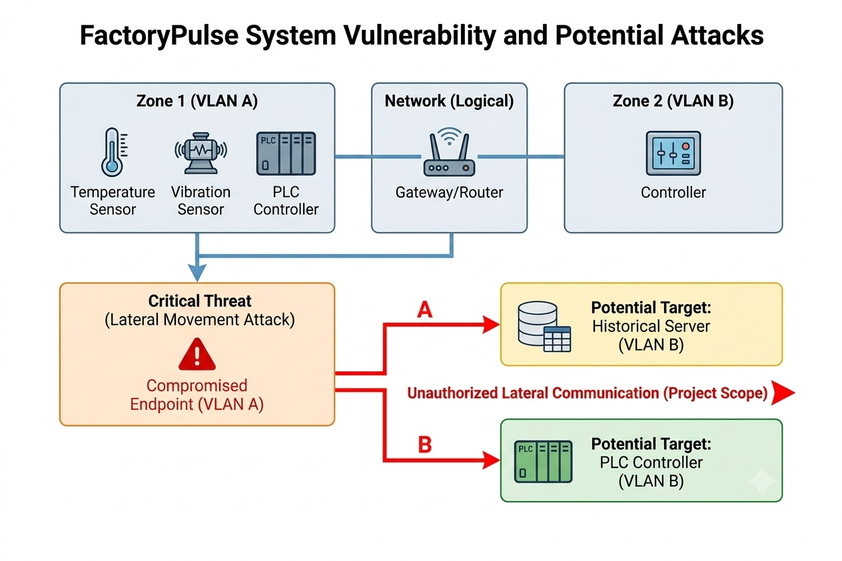
Problem Statement
Modern IoT networks contain devices with different roles, communication patterns and security requirements.
A compromised IoT endpoint can attempt unauthorized communication with other network segments.
Static VLAN and ACL configurations provide segmentation, but do not analyze the behavior of individual endpoints.
Rule-based filtering may not identify abnormal behavior that develops after a device has been compromised.
Manual investigation and access-rule modification can delay the isolation of a suspicious endpoint.
Project Challenge:
Detect abnormal endpoint behavior and use the detected threat information to generate targeted network controls.

Slide 3
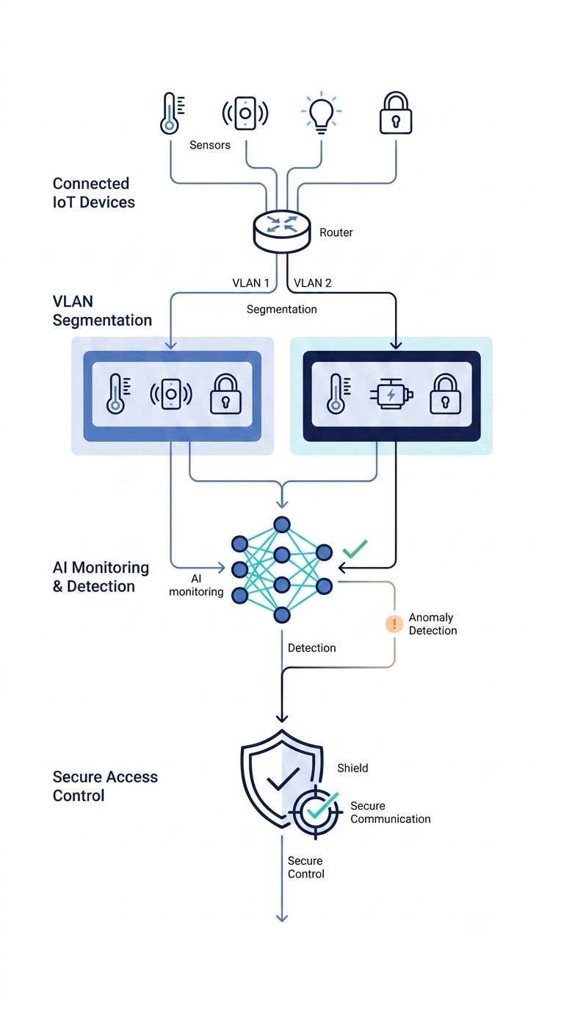
Objectives
Design a segmented IoT network using VLANs for logical isolation.
Control communication between network segments using IPv4 ACLs.
Generate synthetic network and sensor telemetry using Python.
Detect abnormal endpoint behavior using a Deep Learning Autoencoder.
Classify detected anomalies using a Random Forest model.
Generate targeted ACL rules for suspicious endpoints.
Verify traffic restriction using Cisco Packet Tracer.

Slide 4
Existing System
Conventional IoT Network Security
IoT Devices → VLANs → Inter-VLAN Routing → Static ACLs → Administrator
Current Approach:
• VLANs provide logical separation between different device groups.
• Inter-VLAN routing enables communication between required network segments.
• IPv4 ACLs define which traffic is permitted or denied.
• Security rules are configured in advance based on expected communication requirements.
• When abnormal activity is observed, the administrator must investigate the endpoint and modify the network policy.
Limitations
• Static security policies
• No behavioral anomaly detection
• Limited visibility into compromised endpoints
• Manual isolation and policy modification
Key Gap:
The network can control traffic, but it does not independently identify abnormal endpoint behavior and initiate targeted mitigation.

Slide 5
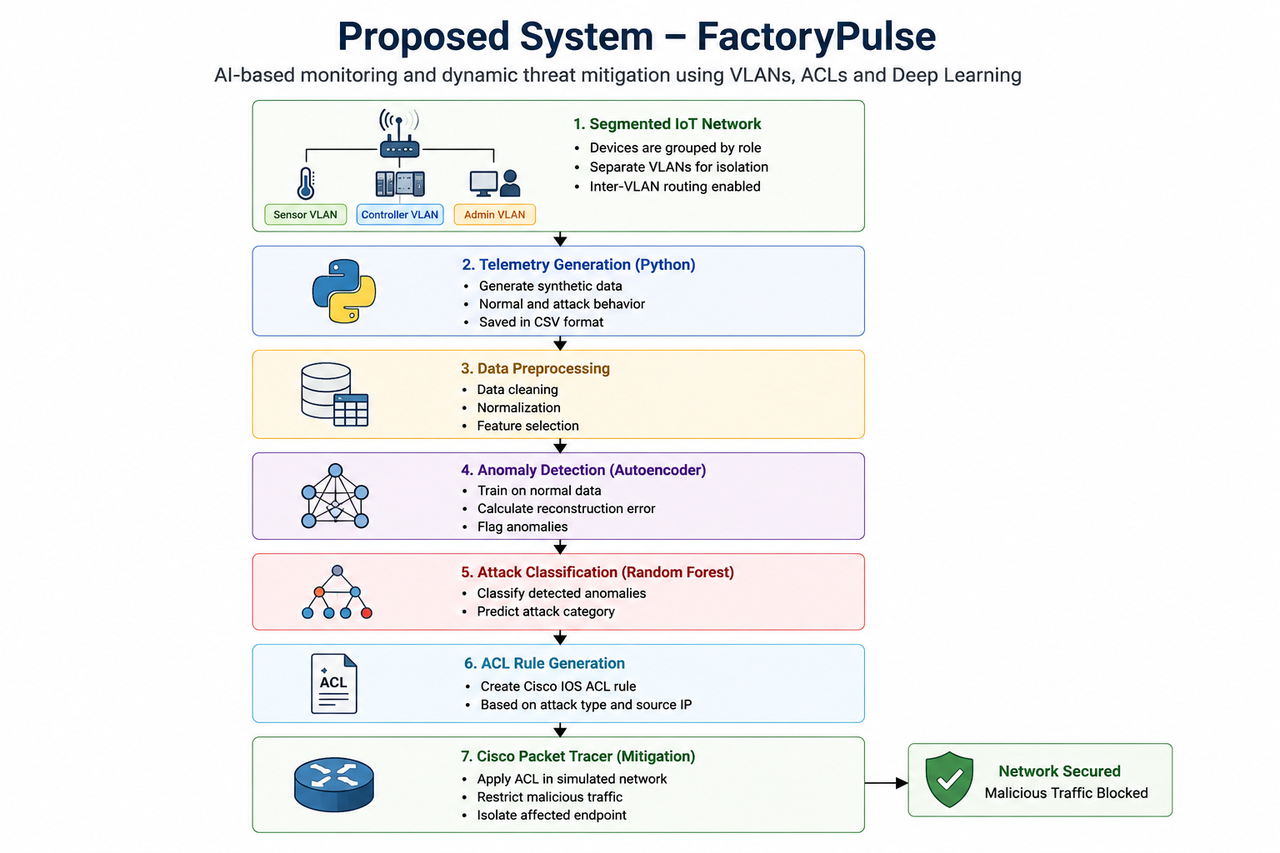
Proposed System

Slide 6
System Architecture
NETWORK LAYER
• Sensor VLAN: Telemetry endpoints
• Controller VLAN: Control systems
• Admin VLAN: Management nodes
TELEMETRY LAYER
• Physical Metrics:
Temp & Vibration
• Network Metrics:
Packet rate tracking
• Connection Activity:
Session state logs
INTELLIGENCE LAYER
• Autoencoder: Learns baseline & flags anomalies
• Random Forest: Classifies attack types
MITIGATION LAYER
• Threat Action: Triggers ACLs
• Cisco IOS: Generates rules
• Validation: Packet Tracer test

Slide 7
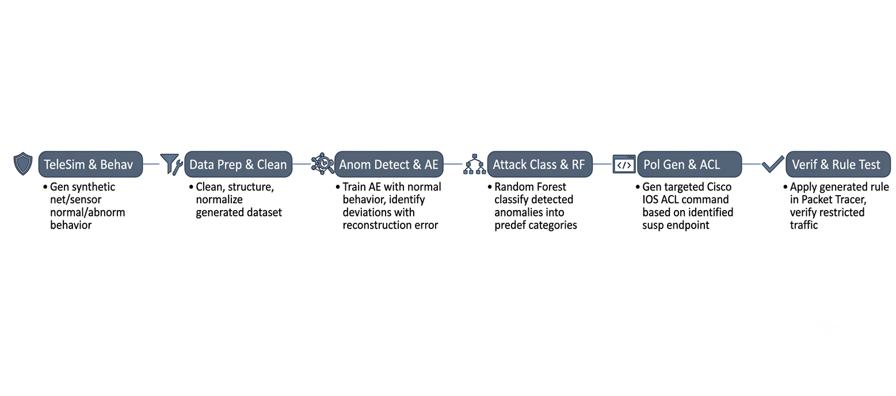
Methodology
Network Design Configure VLANs, IP addressing, inter-VLAN routing and baseline IPv4 ACL policies in Cisco Packet Tracer.
Telemetry Simulation Generate synthetic network and sensor-related features representing normal and abnormal endpoint behavior.
Data Preparation Clean, structure and normalize the generated dataset for model training and inference.
Anomaly Detection Train a Deep Learning Autoencoder using normal behavior and identify deviations using reconstruction error.
Attack Classification Use a Random Forest classifier to categorize detected anomalies into predefined attack classes.
Policy Generation Generate a targeted Cisco IOS ACL command based on the identified suspicious endpoint.
Verification Apply the generated rule in Packet Tracer and verify whether the targeted traffic is restricted.

Slide 8
Technologies & Tools
Computer Networking
• Cisco Packet Tracer
• VLANs and 802.1Q trunking
• Inter-VLAN Routing
• DHCP
• IPv4 Extended ACLs AI / Machine Learning
Deep Learning Autoencoder
• Reconstruction Error
• Random Forest Classifier
• PyTorch / Keras
• Scikit-learn
Development Visualization
• Python
• NumPy
• Pandas
• Streamlit

Slide 9
Expected Outcome & Future Scope
The project is expected to demonstrate:
• Logical isolation of IoT device groups using VLANs.
• Controlled communication between network segments using IPv4 ACL policies.
• Identification of abnormal endpoint behavior using reconstruction-based anomaly detection.
• Classification of predefined attack patterns using supervised machine learning.
• Generation of targeted ACL rules for suspicious endpoints.
• Verification of traffic restriction in a simulated Cisco Packet Tracer environment.
Future Scope:
• Real-time network telemetry collection
• Automated router/firewall integration
• Physical IoT device integration
• Additional attack categories
• Continuous model retraining
• Evaluation on larger and more diverse network environments

Slide 10
Thank You

